Slide 1
A Unified Conditional Framework for Diffusion-based Image Restoration
Presenter: Chen Zhenyuan
Department: School of Earth Science, Zhejiang University
Date: 2024

Slide 2
Outline
Related Work
Generative Image Restoration
Dynamic Networks in Image Restoration
Method
Overview of Conditional Framework
Diffusion Model Block
High-resolution Image Inference
Results
References

Slide 3
Related Work
Generative Image Restoration
Image Deblurring (Nah et al., 2021; Li et al., 2022)
…
Dynamic Networks in Image Restoration
Kernel Prediction(Xia et al., 2020; Jiang et al., 2022)
…

Slide 4
Main Contributions
• We propose a unified conditional framework for diffusion-based image restoration tasks. It leverages a UNet to predict the initial guidance and enable integrating the multi-sources conditional information to every block to better guide the generative model.
• To effectively incorporate conditional information into diffusion models, we design a basic module and an Adaptive Kernel Guidance Block (AKGB). It combines the spatial guidance and auxiliary scalar information to adaptively fuse the dynamic kernels in each diffusion model block.
• A simple yet effective inter-step patch-splitting strategy is proposed for handling high-resolution images in low-level vision tasks. This practical strategy enables diffusion models to generate consistent high-resolution images without grid artifacts.
• Through extensive experiments on extreme low-light denoising, image deblurring, and JPEG restoration tasks, we demonstrate that our method not only achieves a significantly higher perceptual quality than strong regression baselines and recent diffusion-based models but also show good generalization to various restoration tasks.

Slide 5
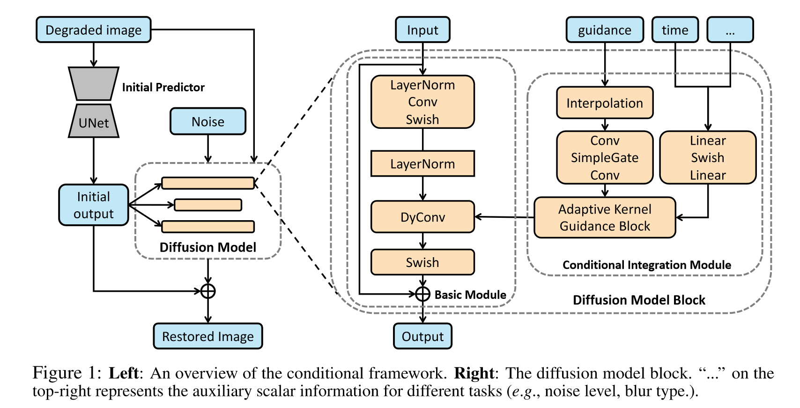
Method
auxiliary scalar information
capture low-frequency and
deterministic aspects
of final image
capture the residual distribution of the initial output

Slide 6
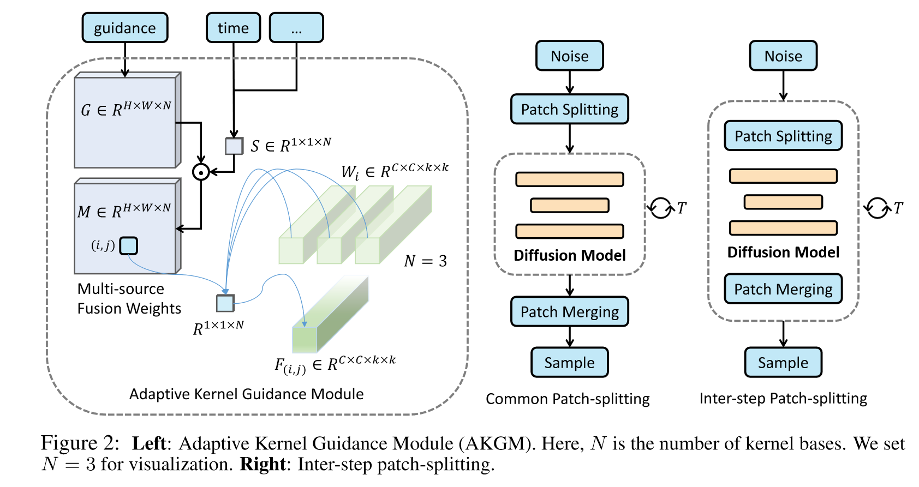
Method

Slide 7
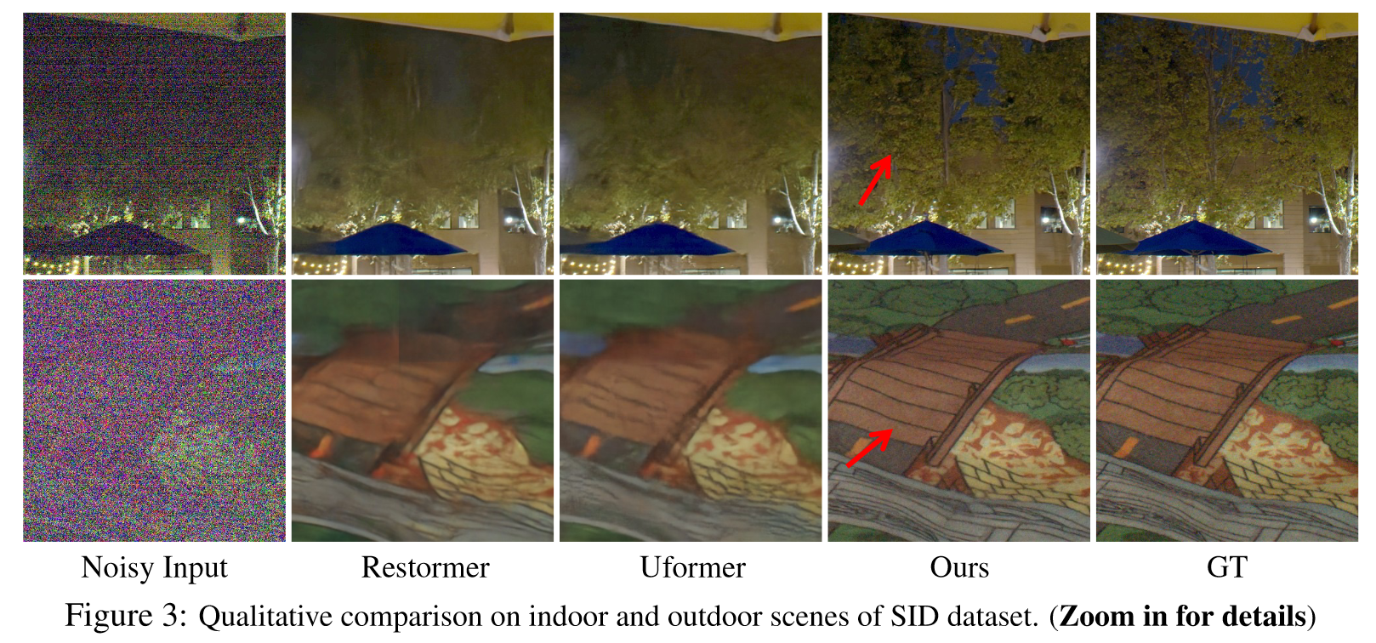
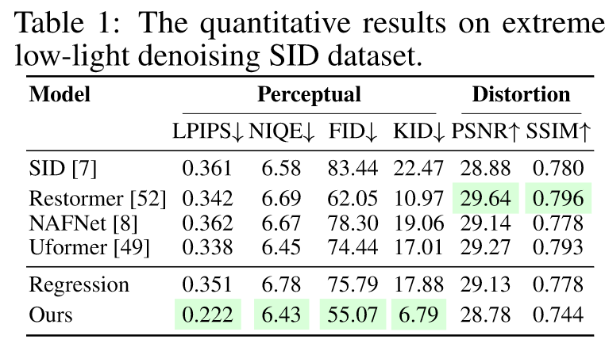
Results
For extreme low-light denoising, we use the SID Sony dataset¹, which provides noisy-clean image pairs with an exposure factor of 300.
1. Chen Chen, Qifeng Chen, Jia Xu, and Vladlen Koltun. Learning to see in the dark. In CVPR, 2018.

Slide 8
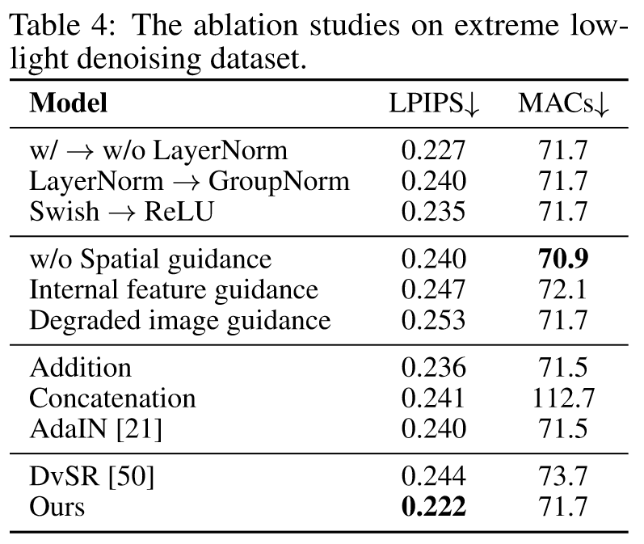
Results
The design of the basic module
removing LayerNorm
replacing the Swish activation functions with ReLU
using GroupNorm
The importance of spatial guidance
removing the spatial guidance branch from our framework
using the internal feature map as the spatial guidance
using the degraded image itself as the spatial guidance
Other integration choices
directly adding the guidance feature map
directly concatenating the guidance feature map
using AdaIN for the guidance feature map

Slide 9
References
Zhang, Y., Shi, X., Li, D., Wang, X., Wang, J., & Li, H. (2023). A Unified Conditional Framework for Diffusion-based Image Restoration. Neural Information Processing Systems, 36, 49703–49714.
Li, D., Zhang, Y., Cheung, K. C., Wang, X., Qin, H., & Li, H. (2022). Learning Degradation Representations for Image Deblurring. European Conference on Computer Vision. https://doi.org/10.48550/ARXIV.2208.05244
Nah, S., Son, S., Lee, S., Timofte, R., Lee, K. M., Chen, L., Zhang, J., Lu, X., Chu, X., Chen, C., Xiong, Z., Xu, R., Xiao, Z., Huang, J., Zhang, Y., Xi, S., Wei, J., Bai, H., Cheng, S., … Jeong, J. (2021). NTIRE 2021 Challenge on Image Deblurring. Proceedings of the IEEE/CVF Conference on Computer Vision and Pattern Recognition, 149–165. https://doi.org/10.1109/CVPRW53098.2021.00025
Xia, Z., Perazzi, F., Gharbi, M., Sunkavalli, K., & Chakrabarti, A. (2020). Basis Prediction Networks for Effective Burst Denoising With Large Kernels. IEEE/CVF Conference on Computer Vision and Pattern Recognition (CVPR), 11841–11850. https://doi.org/10.1109/CVPR42600.2020.01186
Jiang, Y., Wronski, B., Mildenhall, B., Barron, J. T., Wang, Z., & Xue, T. (2022). Fast and High Quality Image Denoising via Malleable Convolution. In S. Avidan, G. Brostow, M. Cissé, G. M. Farinella, & T. Hassner (Eds.), European Conference on Computer Vision (Vol. 13678, pp. 429–446). Springer Nature Switzerland. https://doi.org/10.1007/978-3-031-19797-0_25

